Slide 1
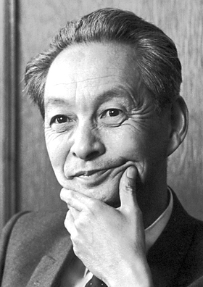
Shin'ichirō Tomonaga
Notes:
# Name Shin'ichirō Tomonaga # Textbook Knight, Physics for Scientists and Engineers: A Strategic Approach with Modern Physics, 3rd Edition, Chapter 30, section 3 # Contributors # Description Shin'ichirō Tomonaga was born on March 31, 1906 in Tokyo, Japan. He is a Japanese scientist who won the Nobel Prize in Physics in 1965 for developing basic principles of quantum electrodynamics. He was a professor of Physics at the Tokyo University of Education. From 1937 to 1939, he was in Germany to study nuclear physics and the quantum field theory. In 1940, he developed the intermediate coupling theory in order to clarify the structure of the meson cloud around the nucleon. During WWII, he solved the motion of electrons in the magnetron and also developed a unified theory of systems consisting of wave guides and cavity resonators. Dr. Tomonaga was the President of the Tokyo University of Education from 1956 to 1962. He has actively campaigned against the spread of nuclear weapons and for peaceful use of nuclear energy. # Sources https://www.britannica.com/biography/Tomonaga-Shinichiro https://www.nobelprize.org/nobel_prizes/physics/laureates/1965/tomonaga- bio.html https://en.wikipedia.org/wiki/Shin%27ichir%C5%8D_Tomonaga # Photo https://upload.wikimedia.org/wikipedia/commons/3/3a/Tomonaga.jpg

